Slide 1


Algoritmi de sortare
Iftimi Ruxandra
Grupa 134
https://github.com/ruxiii

Slide 2


Cuprins
1. Biblioteci + declarari
2. Counting Sort
3. Merge Sort
4. Quick Sort
5. Radix Sort
6. Shell Sort
7. Functie pentru apelul sortarilor
8. Testele (pregatire + generare)
9. Main
10. Fisierul “date.in”
11. Comparatii
12. Rapoarte

Slide 3
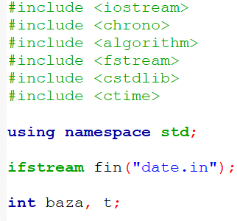
Biblioteci + declarari

Slide 4
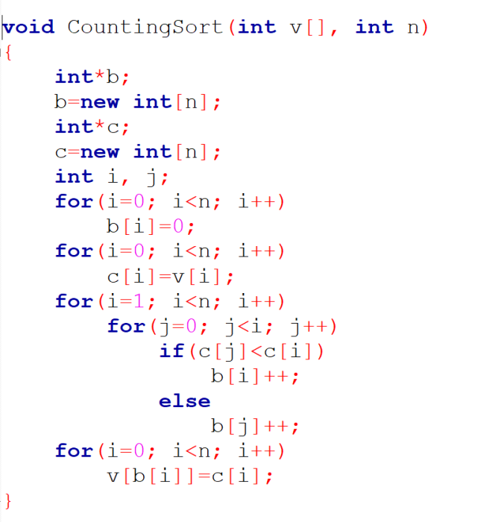
Counting Sort
COMPLEXITATE: O(n)

Slide 5
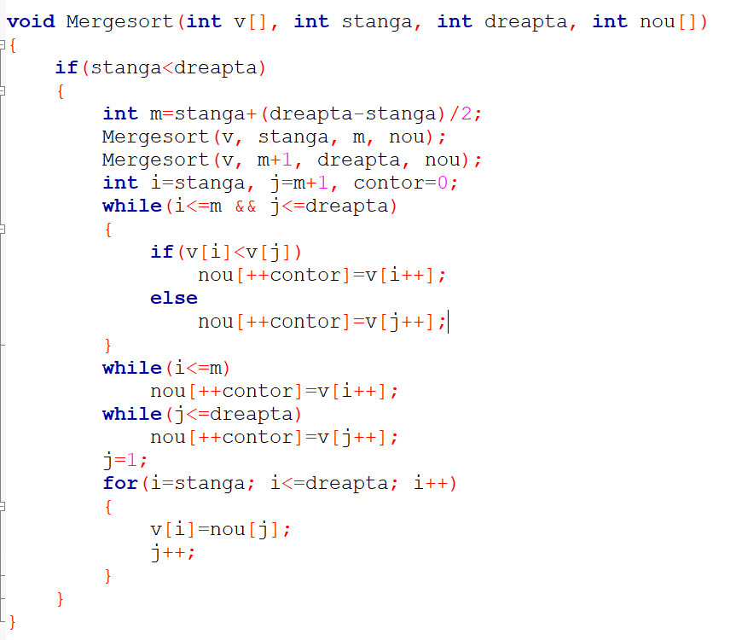
Merge Sort
COMPLEXITATE: O(n*logn)

Slide 6
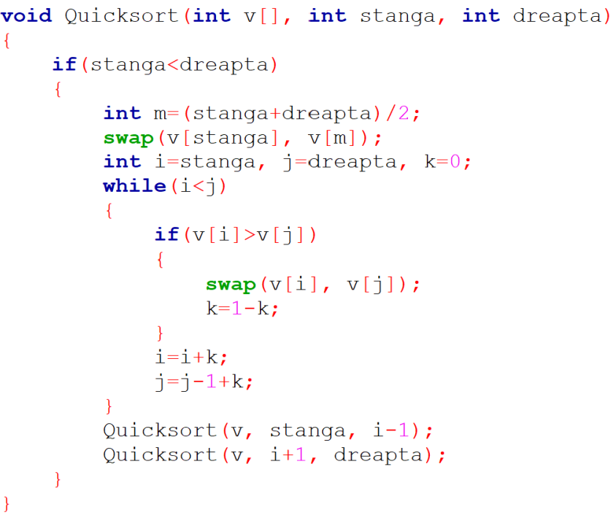
Quick Sort
COMPLEXITATE: O(n*logn)

Slide 7
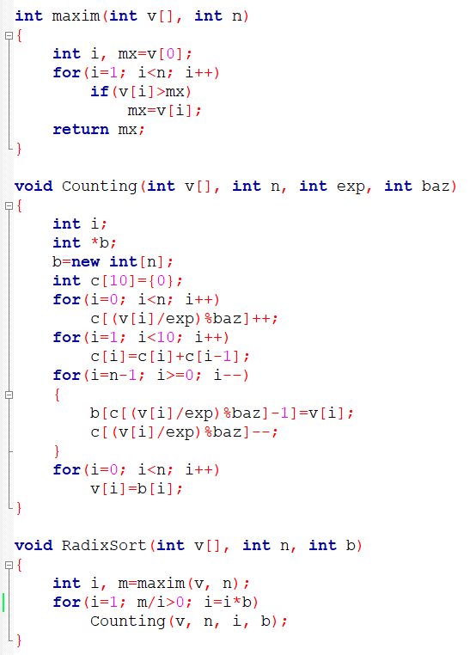
Radix Sort
COMPLEXITATE: O(n*k)
n = numarul de cifre
k = lungimea numerelor

Slide 8
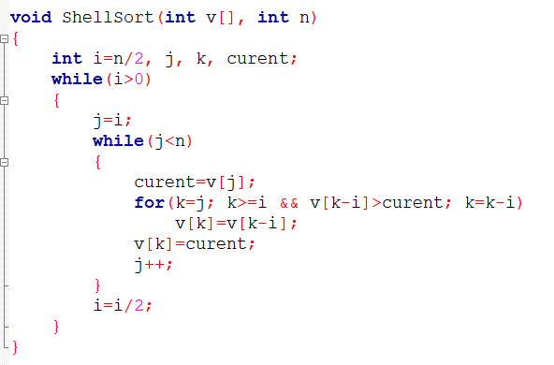
Shell Sort
COMPLEXITATE:
Best case: O(n*logn)
Worst case: O(n² )

Slide 9
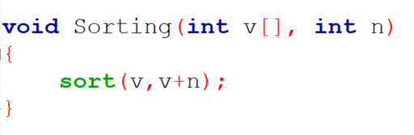
Sort

Slide 10
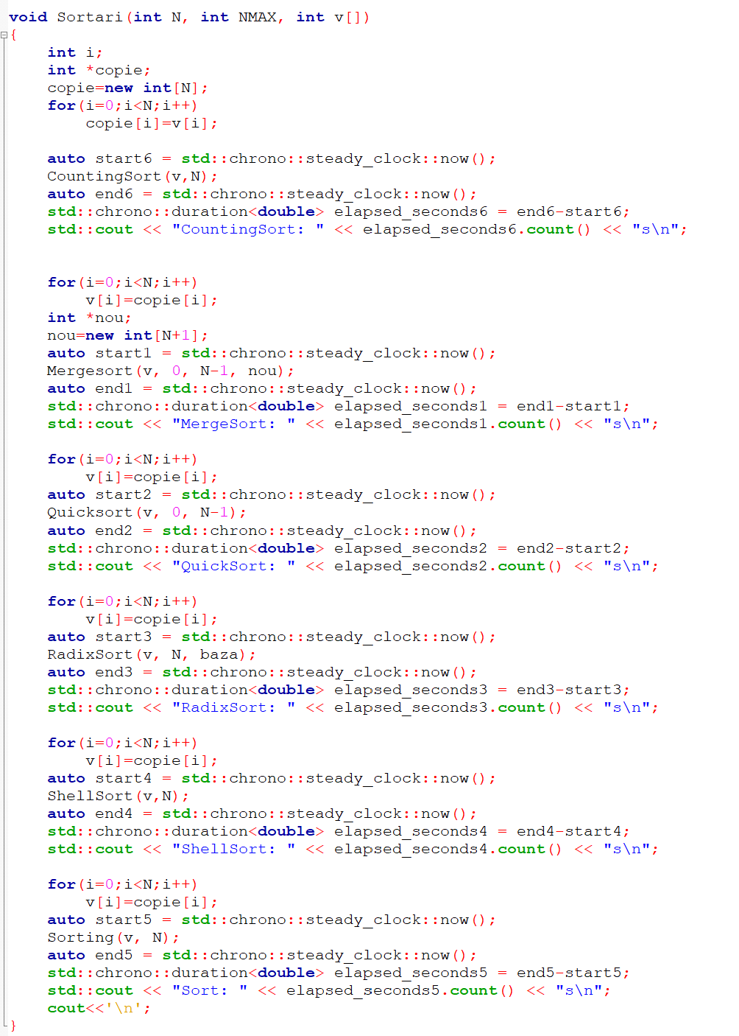
Functie pentru apelul sortarilor

Slide 11
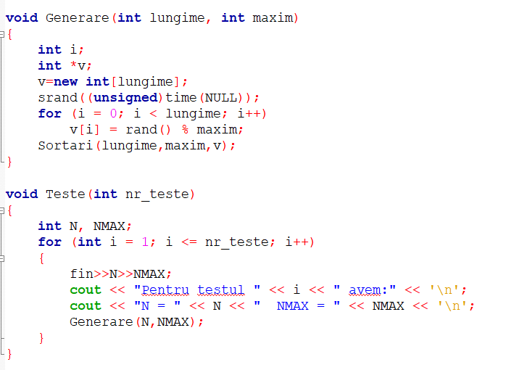
Testele (pregatire + generare)

Slide 12
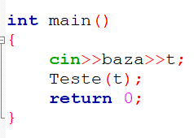
Main

Slide 13
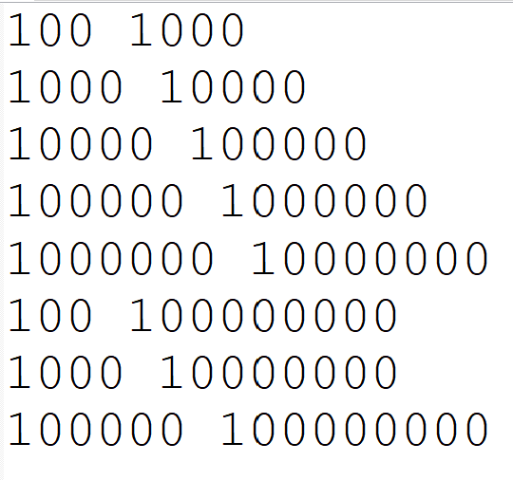
Fisier “date.in”

Slide 14
COMPARATII
Sortare/Exemplu | COUNTING SORT | MERGE SORT | QUICK SORT | RADIX SORT | SHELL SORT | SORT (algorithm)
T1 N=100, MAX=1000 | 0,0000092s | 0,0000039s | 0,0000032s | 0,0000028s | 0,0000029s | 0,0000024s
T2 N=1000, MAX=10000 | 0,0007558s | 0,0000445s | 0,000036s | 0,0000293s | 0,0000458s | 0,0000302s
T3 N=10000, MAX=100000 | 0,1000608s | 0,0008532s | 0,0005279s | 0,0003583s | 0,00069s | 0,0003893s
T4 N=100000, MAX=1000000 | 10,8628s | 0,0068875s | 0,0063378s | 0,0032092s | 0,0091722s | 0,0047895s
T5 N=1000000, MAX=10000000 | 1289,25s | 0,0824963s | 0,0847662s | 0,0512798s | 0,12933s | 0,0536766s
T6 N=100, MAX=100000000 | 0,0000131s | 0,000005s | 0,000004s | 0,0000039s | 0,0000025s | 0,0000021s
T7 N=1000, MAX=10000000 | 0,0007308s | 0,0000401s | 0,0000389s | 0,0000341s | 0,0000411s | 0,0000269s
T8 N=100000, MAX=100000000 | 9,97398s | 0,0063306s | 0,0054968s | 0,0033165s | 0,007983s | 0,0042149s

Slide 15
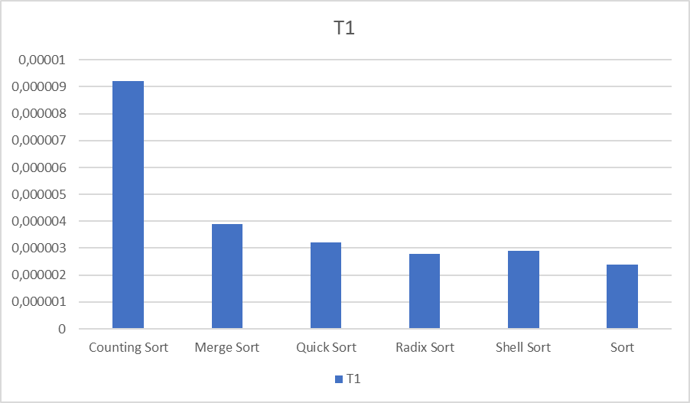

Slide 16
Sort << Radix Sort << Shell Sort << Quick Sort << Merge Sort << Counting Sort
0,0000024s << 0,0000028s << 0,0000029s << 0,0000032s << 0,0000039s << 0,0000092s

Slide 17
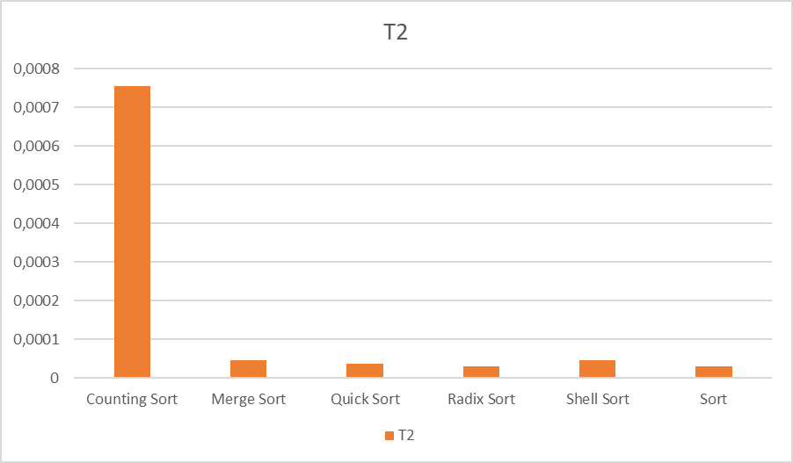

Slide 18
Radix Sort << Sort << Quick Sort << Merge Sort << Shell Sort << Counting Sort
0,0000293s << 0,0000302s << 0,000036s <<0,0000445s<< 0,0000458s << 0,0007558s

Slide 19
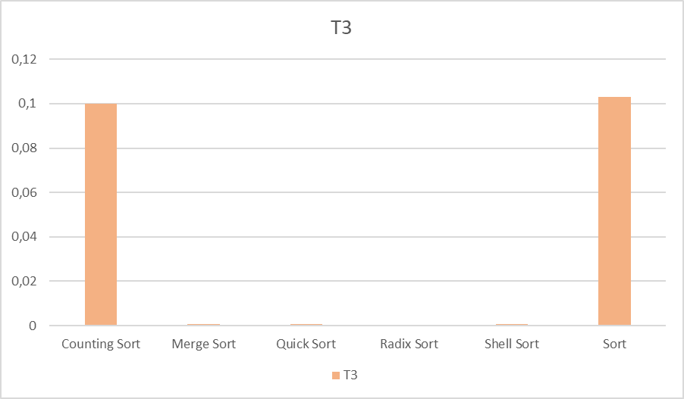

Slide 20
Radix Sort << Sort << Quick Sort << Shell Sort << Merge Sort << Counting Sort
0,0003583s << 0,0003893s << 0,0005279s <<0,00069s<< 0,0008532s << 0,1000608s

Slide 21
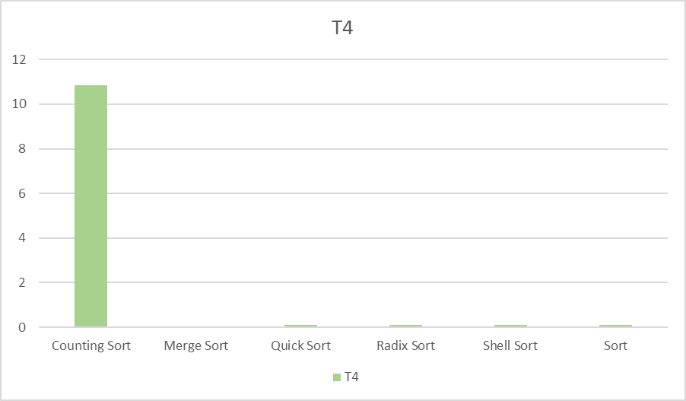

Slide 22
Radix Sort << Sort << Quick Sort << Merge Sort << Shell Sort << Counting Sort
0,0032092s << 0,0032092s << 0,0063378s << 0,0068875s << 0,0091722s << 10,8628s

Slide 23
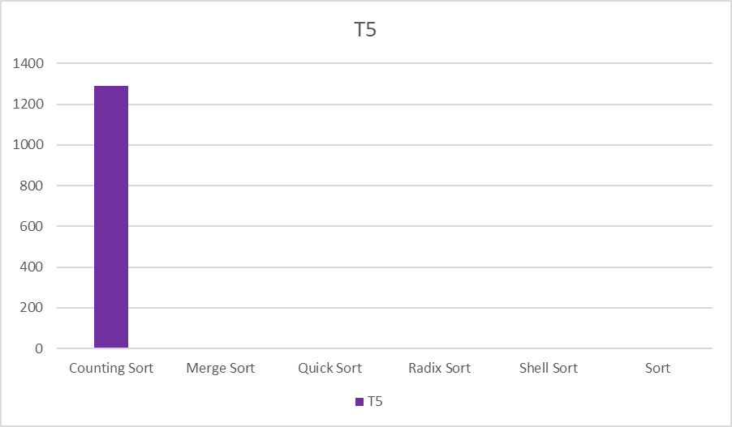

Slide 24
Radix Sort << Sort << Merge Sort << Quick Sort << Shell Sort << Counting Sort
0,0512798s << 0,0536766s << 0,0824963s << 0,0847662s << 0,12933s << 1289,25s

Slide 25
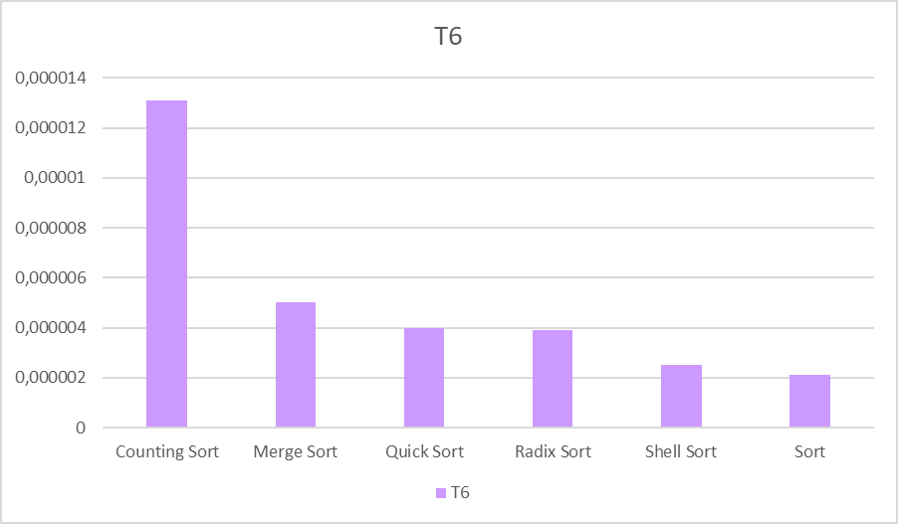

Slide 26
Sort << Shell Sort << Radix Sort << Quick Sort << Merge Sort << Counting Sort
0,0000021s << 0,0000025s << 0,0000039s << 0,000004s << 0,000005s << 0,0000131s

Slide 27
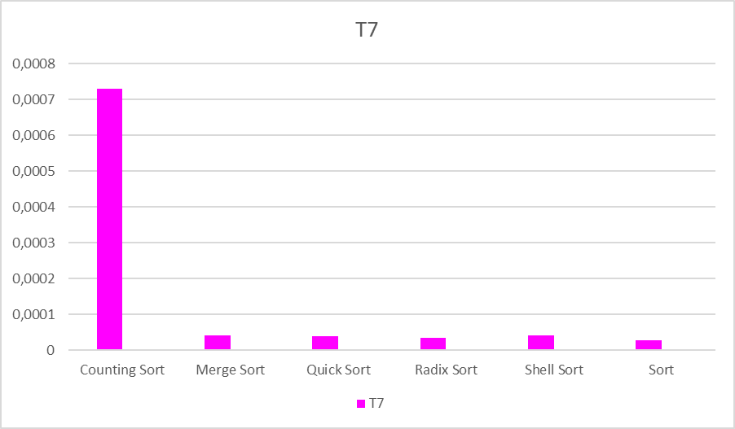

Slide 28
Sort << Radix Sort << Quick Sort << Merge Sort << Shell Sort << Counting Sort
0,0000269s << 0,0000341s << 0,0000389s << 0,0000401s << 0,0000411s << 0,0007308s

Slide 29
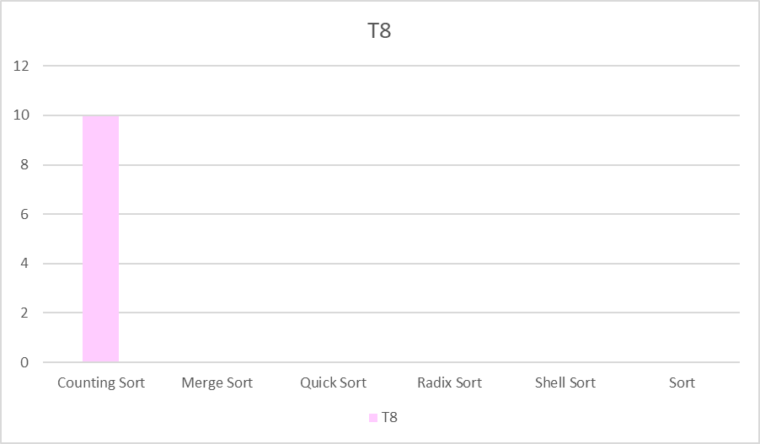

Slide 30
Radix Sort << Sort << Quick Sort << Merge Sort << Shell Sort << Counting Sort
0,0033165s << 0,0042149s << 0,0054968s << 0,0063306s << 0,007983s << 9,97398s

